Slide 1
Larkspur-Corte Madera School District
Second Interim 2022-23
Paula Rigney, Chief Business Official
March 8, 2023
230 Doherty Drive, Larkspur, CA 94939 / 415-927-6960

Slide 2
Strategic Priorities
Foster healthy, inclusive, respectful, and safe learning environments. Promote the social, emotional, and intellectual growth of all community members.
Inspire academic growth and civic responsibility through a rigorous, inquiry-based curriculum that is engaging and personalized.
Attract, cultivate, and retain innovative, inspirational educators.
Sustain the fiscal integrity and stability of the district.
Facilitate collaborative partnerships between students, families, schools, and community.

Slide 3
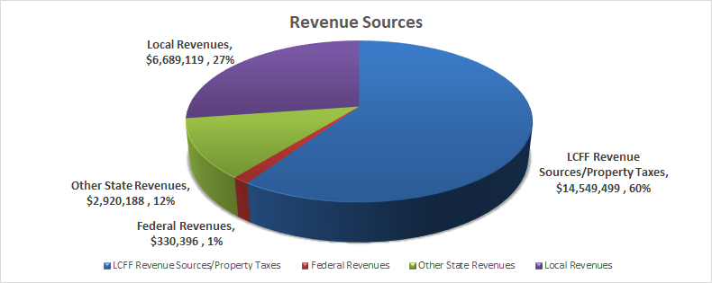
Revenue Sources

Slide 4
Revenue Changes
Revenue Source: Combined Unrestricted & Restricted | Budget Adoption | First Interim | Second Interim | Total Change Between Reportings
Property Tax/LCFF Limit Sources increase in LCFF funding | $14,313,569 | $14,575,999 | $14,549,499 | $(-) 26,500
Federal Revenues (Special Ed., Title I-IV, LLM funds) increase in Learning Loss Mitigation funds | $ 320,396 | $ 328,887 | $ 330,396 | $ 1,509
Other State Revenues (Lottery, Special Ed., ESSER) increase in STRS/PERS “on-behalf” accounting and ESSER (one-time ELO Grant, 2021 EE Grant) | $ 1,616,093 | $ 3,064,182 | $ 2,920,188 | $(-) 143,994
Other Local Income (Leases/Rentals, Fees, County Special Ed., Grants) | $ 5,379,973 | $ 5,435,130 | $ 5,438,132 | $ 3,002
Foundation | $ 1,250,000 | $ 1,209,106 | $ 1,209,106 | $ 0
Total Revenues | $22,875,938 | $24,655,185 | $24,489,203 | $(-) 165,982

Slide 5
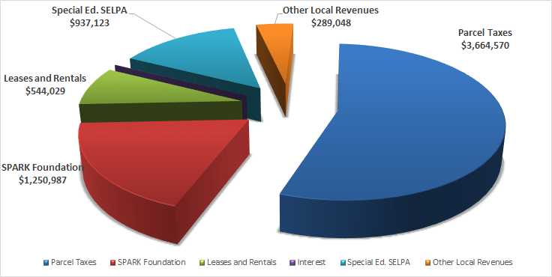
Local Revenue

Slide 6
Expenditure Changes
Expenditure Source: Combined Unrestricted & Restricted | Budget Adoption | First Interim | Second Interim | Total Change
Certificated & Classified Salaries actual placement as of January 2023 | $13,435,135 | $13,163,753 | $13,409,238 | $ 245,485
Certificated & Classified Benefits actual expenses as of October 2021/Addt. Of STRS/PERS on-behalf” | $ 6,222,395 | $ 6,178,851 | $ 6,130,622 | $(-) 48,229
Books & Supplies Addition Of carry-over, one-time funding and program needs | $ 459,852 | $ 648,821 | $ 693,988 | $ 45,167
Services & Operating Expenditures Addition Of carry-over, one-time funding and program needs | $ 2,698,565 | $ 3,313,348 | $ 3,133,678 | $(-)179,670
Other Outgo/Transfers Out | $ 502,650 | $ 542,727 | $ 516,841 | $ 25,886
Total Expenditures | $23,318,595 | $23,847,499 | $23,906,567 | $ 59,068
Notes:
Why did our benefits go up so much?

Slide 7
Expenditure Changes
Salary and Benefit changes adjusted to reflect actual staffing through January 31, 2023
Adjustments to non-staffing budgets to reflect current commitments and programs
Update to anticipated State and Federal categorical carryover of expenditures (restricted funds)

Slide 8
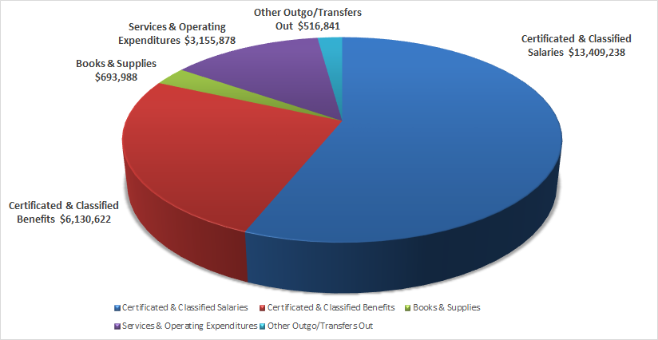
Expenditures

Slide 9
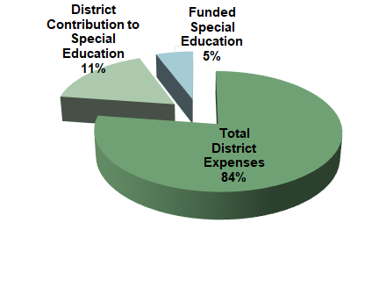
Special Education
SPECIAL EDUCATION PROGRAM COSTS, 2022-23
School districts throughout the state face a continuing challenge in funding the costs of serving Special Education students. LCMSD is proud of the Special Education support provided to its students, but the District is also faced with mounting increases in the difference between the federal and state governments' funding and the mandated costs for these vital student services. The federal government has not provided the funding that was envisioned when the laws mandating programs for Special Education students were adopted.
This shortfall in dedicated funding has led to very significant contributions from the District's Unrestricted General Fund. During 2022-23, it is estimated that LCMSD will contribute $2,709,986 from the District's Unrestricted General Fund to cover the costs for Special Education.

Slide 10
2022-23 Second Interim Revenue and Expenditure Summary
Budget Adoption First Interim Second Interim
Total Revenues $ 22,875,938 $ 24,655,185 $24,489,203
Total Expenditures $ 23,318,595 $ 23,847,499 $23,906,567
Net +/- $ -442,657 $ 807,687 $ 582,636

Slide 11
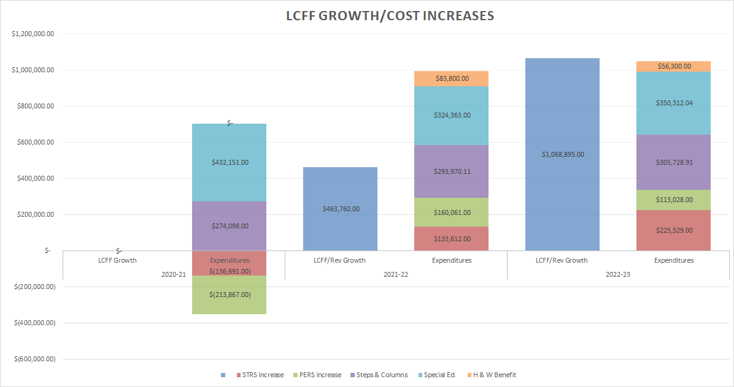

Slide 12
Assumptions in 2022-23 Multi-Year Projections (Revenue)
Property Tax Growth:
2022-23, 5.28% property tax growth from previous year and a estimated 4.0% property tax growth in the out years (2023-24 through 2024-25)
Please note that 1% of property tax growth is approximately $127K
LCFF Revenue Assumptions: From 2022-23 through 2024-25
Significant Decrease in ADA (268.8 since 2019-20) and projecting relatively flat enrollment from this point on. Due to district’s declining enrollment, the California Department of Education allows a district to use the highest ADA between three methods: current year and prior year P-2 attendance reporting, the average ADA for the past three years and/or the highest ADA percentage factor.
96% ADA to enrollment
COLA to LCFF Base:
2022-23 6.56% plus LCFF Investment COLA specific for each grade span
2023-24 8.13%
2024-25 3.54%
Notes:
Paula

Slide 13
Assumptions in 2022-23 Multi-Year Projections (Revenue)
SPARK contribution projected at $1,250,987 for 2022-23 through 2024-25
Subject to change dependent on fundraising
Lottery Revenues funded from 2022-23 through 2024-25
2022-23 $170 per ADA (unrestricted) & $67 per ADA (restricted)
2023-24 $170 per ADA (unrestricted) & $67 per ADA (restricted)
2024-25 $170 per ADA (unrestricted) & $67 per ADA (restricted)
Mandated Block Grant funded from 2022-23 through 2024-25
2022-23 $34.94 per ADA
2023-24 $37.78 per ADA
2024-25 $39.12 per ADA
Notes:
Paula

Slide 14
Assumptions in 2022-23 Multi-Year Projections (Revenue)
Federal Revenue Estimated Reductions of 12% from 2022-23 through 2024-25 (for Title I-IV)
Special education flat funded from 2022-23 through 2024-25
Addition of one-time special ed. mental health/remediation funding
Parcel tax projected at current number of parcels with 5% escalation from 2022-23 through 2024-25 (current parcel tax expires June 30, 2032)
Lease revenue based upon current signed leases 2022-23 through 2024-25
Local revenue based upon current budgeted facility rentals from 2022-23 through 2024-25
Notes:
Paula

Slide 15
Assumptions in 2022-23 Multi-Year Projections (Expenditures)
Staffing assumptions:
Step and Column included
2022-23 2.25% increase on salary schedule
2023-24 0.0% increase on salary schedule
2024-25 0.0% increase on salary schedule
Benefit changes due to approved tentative agreement
Health and Welfare Cap $11,250, 2022-23 through 2024-25
Staffing included in 2022-23 based on staffing needs as of January 31, 2023
Staffing in 2023-24
Reduction of approximately 6.5 FTE from 2022-23 in order to provide additional compensation to LCMSD staff and maintain District’s fiscal solvency and needs
Staffing in 2024-25
Currently the same as 2023-24 but subject to change based on the District’s fiscal solvency and needs
Notes:
Paula

Slide 16
Assumptions in 2022-23 Multi-Year Projections (Expenditures)
STRS and PERS Rates: Based on the current enacted legislation and budget adoption
STRS: 19.1% in 2022-23, 19.1% in 2023-24, 19.1% 2024-25
PERS: 25.37% in 2022-23, 27.0% in 2023-24, 28.1% 2024-25
Operational expenditures based on the current rates, contracts, agreements, MOU’s, etc.
One-time funding expenditures incorporated for 2022-23 through 2024-25
Notes:
Paula

Slide 17
Reductions From the General Fund
Position | FTE | Cost | Notes
Literacy Coach | .6 | $86,720 | .1 reduced .5 shifted to restricted PD funding
Elementary Math Intervention and Coaching | .7 | $98,074 | .2 to LAMP .5 shifted to restricted PD funding
Elementary Art | 1.0 | $108,542 | Shifted to restricted Prop 28 funding
Paraprofessional, Specialized | 1.625 | $133,043 | Temporary funded positions due to class size and locker room coverage
Subtotal of reductions from the general fund | Certificated: 2.3 Classified: 1.625 | $426,379

Slide 18
Reductions to Programs
Position | FTE | Cost
Hall Math Intervention | .2 | $18,121
Equity Coach | .4 | $57,814
Elementary Literacy Intervention | 1.0 | $142,532
Hall EL Intervention | .2 | $24,046
Hall Math | .4 | $31,736
Hall ELA | .4 | $53,230
Hall Physical Education | .6 | $86,720
Hall Electives | 3.2 | $400,000
Subtotal of Reductions to Programs | Certificated: 6.4 | $814,199
Total | 10.325 | $1,240,578

Slide 19
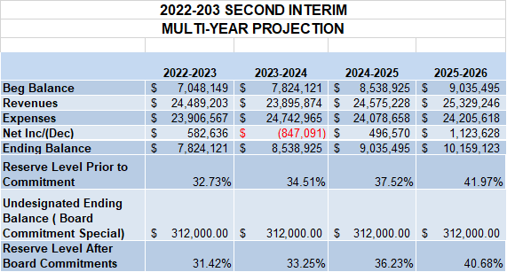

Slide 20
Challenges
Revenues and enrollment
Property tax rate trends still unknown due to the current state of the world/national economy
Significant enrollment decline since COVID-19
Special Education costs continue to increase
Multi-Year Projection: develop financial projections and contingency plans accordingly to meet the state/federal/local requirements
Increase in employer contributions toward STRS & PERS
Reserve level: districts are advised to maintain reserves much greater than the State-required minimum
Competitive local salaries and benefits

Slide 21
Celebrations
Parcel tax
SPARK Foundation
PTA/PTO
LCAP focus on equity, achievement, and wellness
Programs far beyond state requirements
New and modernized facilities
Notes:
Brett

Slide 22
Larkspur-Corte Madera School District
Second Interim 2022-23
Paula Rigney, Chief Business Official
March 8, 2023
230 Doherty Drive, Larkspur, CA 94939 / 415-927-6960

